Slide 1
A Decentralized approach to collect government service tax using Blockchain
Supervised by
Professor Dr. M.M.A. Hashem
Department of Computer Science and Engineering
Khulna University of Engineering & Technology
Presented by
Name: | Sajidul Islam
Roll: | 1707010
Name: | Samiul Baree Sifat
Roll: | 1707035
Presentation Date: 24/08/2022

Slide 2
Outline
Introduction
03
Our Goal
04
Blockchain
06
Ethereum
11
Smart Contracts
14
Proposed Model
18
Timeline
21

Slide 3
Introduction
Government service tax such as road toll, entry fee in any government powered establishment etc. is sometimes have been worrying part of the taxation.
There is possibilities of corruption such as tax fraud, more then allocated tax etc.
Trying to minimize the problems here is a necessity.
One approach could be to make the system decentralize so that these problems does not happen.

Slide 4
Our Goal
Our goal is to try to prevent the corruption that’s happening by:
Increase security by using blockchain.
Make the process faster than before.
Transparency.
Immutablity.

Slide 5
Blockchain

Slide 6
Blockchain
A Blockchain is a type of Digital Ledger Technology that consists of growing list of Records, called Blocks, that are securely linked together using cryptography.
- Wikipedia

Slide 7
Block Representation
1. Data: “Hello World!”
2. Prev. Hash: 1894A19C85
3. Own Hash: 43FC004C891
Figure–1: Block representation of a blockchain

Slide 8

Visual Representation of blockchain
Genesis Block
1
2
3
4
1. Data: XXXXXX
1. Data: AAAAAAAA
1. Data: BBBBBBB
2. Prev. Hash: 000000000
2. Prev. Hash: 1894A19C85
2. Prev. Hash: 43FC004C8
3. Own Hash: 43FC004C8
3. Own Hash: D4AF6C43FD
3. Own Hash: 1894A19C85
Figure–2: Visual Representation of Blockchain

Slide 9


Attack on a Blockchain
1
2
3
4
ZZZZZZZ
1. Data: XXXXXX
1. Data: BBBBBBBBB
1. Data: BBBBBBB
2. Prev. Hash: 000000000
2. Prev. Hash: 43FC004C8
2. Prev. Hash: 1894A19C85
3. Own Hash: 43FC004C8
3. Own Hash: 1894A19C85
3. Own Hash: D4AF6C43FD
1604B26F8C
“BLOCKS ARE CRYPTOGRAPHICALLY LINKED TOGETHER”

Slide 10
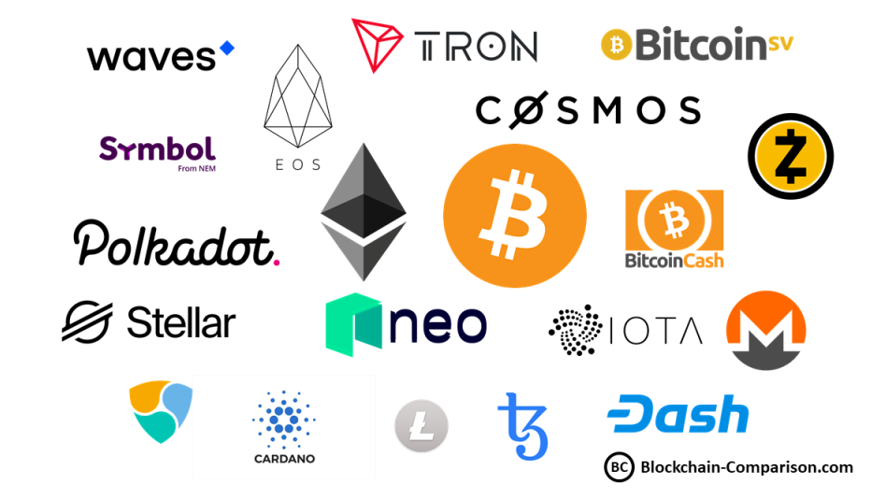
Different Blockchain Protocols

Slide 11
Ethereum

Slide 12

Ethereum
Ethereum is a decentralized, open-source blockchain with smart contract functionality. Ether is the native cryptocurrency of the platform. Among cryptocurrencies, Ether is second only to Bitcoin in market capitalization.

Slide 13
Why Ethereum
Supports decentralized Applications.
Smart contracts.
Communicate with the chain Using Solidity.
Cognitive Currency, Ether (ETH).

Slide 14
Smart Contracts

Slide 15

Smart Contracts
Figure–3 Smart Contract in a Blockchain
A smart contract is an agreement, in the form of a computer program that is executed automatically once certain pre-programmed conditions are satisfied.

Slide 16
Smart Contracts
Transparency
Autonomy
Cost Reduction
Speed
Security

Slide 17
Proposed Model

Slide 18
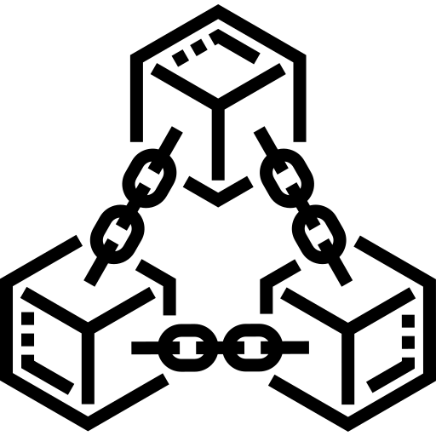
Registration
Interface
Execute Transaction
User Payment
Tax Paid
User Account
User Information
Transaction list updated in blockchain
Blockchain
Store user information
User private key
User public key
Figure–4: Proposed Model

Slide 19
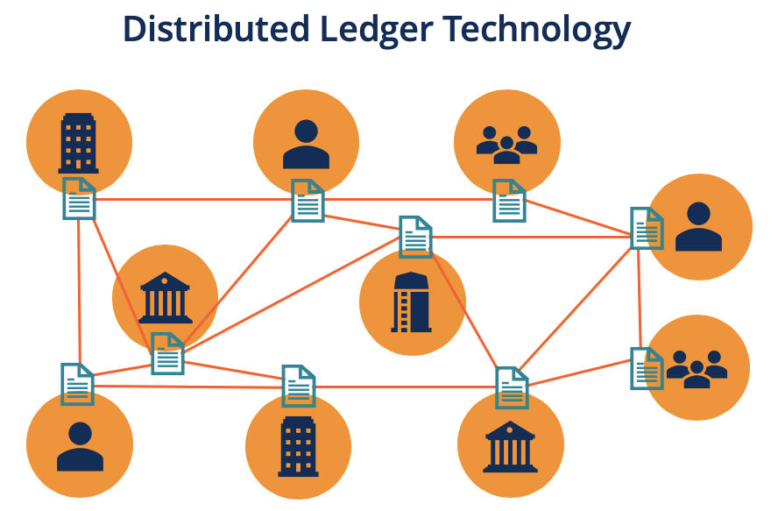
Why this approach?
It brings transparency to the system.
It makes system autonomous.
Helps making transaction faster and more secure.
Reduces Cost.
More secure then traditional approach.
Figure–5: Distributed Ledger Technology

Slide 20
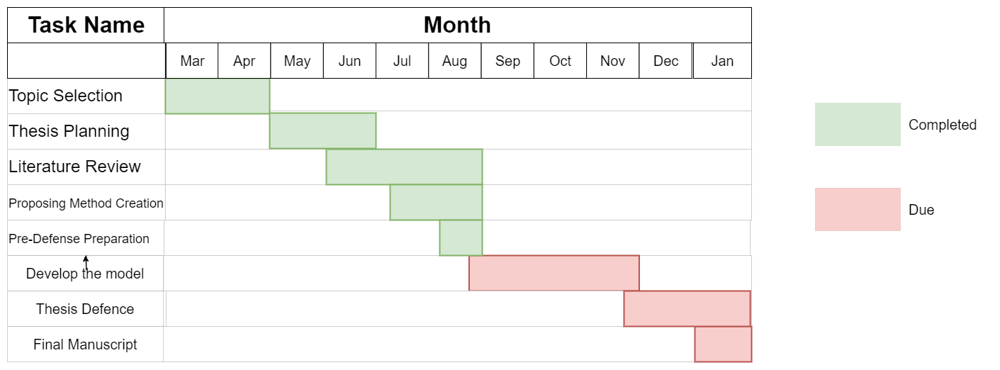
Timeline
Figure–6: Timeline Diagram

Slide 21
References
Daniel Zinca and Vlad-Andrei Negrean. Development of a road tax payment application using the ethereum platform. In 2018 International Symposium on Electronics and Telecommunica- tions (ISETC), pages 1–4. IEEE, 2018.
Satoshi Nakamoto. Bitcoin: A peer-to-peer electronic cash system. Decentralized Business Review, page 21260, 2008.
Vitalik Buterin et al. A next-generation smart contract and decentralized application platform white paper, 3(37):2–1, 2014.
What is Ethereum? By Alex Moskov < https://coincentral.com/>

Slide 22
Thank You
22

